Slide 1
ThreshNet: a novel machine learning technique to optimize sensitivity and specificity performance
(Shirley Xu)
In image classification, sensitivity and specificity are metrics that are often inversely related. Achieving both high sensitivity and specificity is not always possible for a given neural network, and trade-off between them is not easily controllable. This project proposes “ThreshNet”, a novel method to address this dilemma.
ThreshNet is composed of an ensemble of different neural networks. Many well-known networks were leveraged through transfer learning. With custom designed dense layers, network parameters were tuned to optimize performance and enhance diversity.
To yield the ThreshNet system’s decision, a threshold-based algorithm is proposed. Demonstrated with a brain tumor MRI dataset, ThreshNet systems consistently outperform individual networks. Specific sensitivity-specificity trade-off and optimization goals can conveniently be achieved by adjusting the threshold parameter. Performance variance among ThreshNet systems are smaller than those among individual networks.
To locate tumor(s) predicted by ThreshNet, a ResUNet-based image segmentation model was developed, achieving a Tversky index of 90.49%.

Slide 2
Introduction
Binary classification is the task of dividing a set of elements into two groups based on a classification rule. In medical diagnoses, binary classification can be utilized to determine whether a patient has a condition or not.
Widely used in medical diagnoses, sensitivity and specificity are important statistical measures of a binary classification test’s performance. Sensitivity is a test’s ability to correctly identify those with the disease (true positive rate). Specificity is a test’s ability to correctly identify those without the disease (true negative rate). Often inversely related, selecting an optimal balance between sensitivity and specificity is crucial, depending on the purpose of the test and/or the severity of the diagnosed disease. While detecting brain tumors for example, a false negative (missing the presence of a brain tumor) could lead to detrimental consequences such as delayed treatment. Thus, for brain tumor applications, a highly sensitive diagnosis is desired.
Machine learning techniques are widely used in the medical imaging diagnosis field. Many publications investigate the development of a well-performing neural network. However, high performance is not always achievable with a single network. In addition, the sensitivity specificity balance may not be easily controllable or tunable.
This project proposes “ThreshNet”, a system which not only utilizes ensembles of neural networks to achieve specific sensitivity specificity goals but also improves both performance metrics in many cases. To help medical professionals visualize the data from our “ThreshNet” system, ResUNet (a popular segmentation model) is also implemented.

Slide 3
Framework
Step 1: Importing and Preprocessing Data
Step 2: Develop individual neural networks
Tens of neural networks were developed in total
33 individual nets (each with >91% accuracy) were chosen as candidates for the next steps
Notes:
Search out what dropout function is
What is softmax

Slide 4
Framework
Step 3: Implement and test “ThreshNet” systems
Randomly select 9 networks from Step 2 as ensemble members of a ThreshNet system.
Sum all decisions (0: no tumor; 1: tumor present) of the 9 networks in a)
Compare the sum in b) against the ThreshNet parameter (set as 1 to 6 depending on application) to generate the system’s decision
Repeat steps a) - c) to generate total of 10 ThreshNet systems
This demonstrates the trend of results are not sensitive to particular selections of individual networks
Test / compare performance of the “ThreshNet” system and individual networks

Slide 5
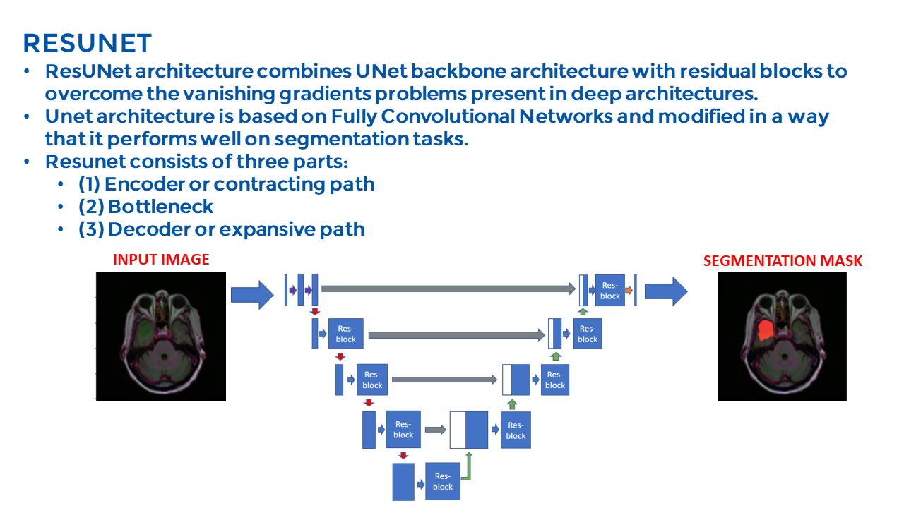
Framework
Step 4: Implement, test image segmentation ResUNet
Input image
ResUNet Illustration
If ThreshNet predicts a positive diagnosis, move on to Step 4
Segmentation mask
(overlayed on top
of input image)
ResUNet is based off UNet (a “U”-shaped fully convolutional network often used in image segmentation applications) and residual blocks
ResUNet consists of three parts:
Encoder Path (res-blocks & maxPooling)
Decoder Path (res-blocks & upSampling)
Bottleneck (connection between Encoder Path and Decoder Path)

Slide 6
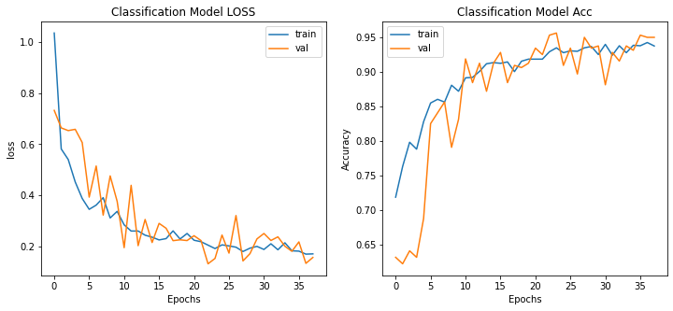
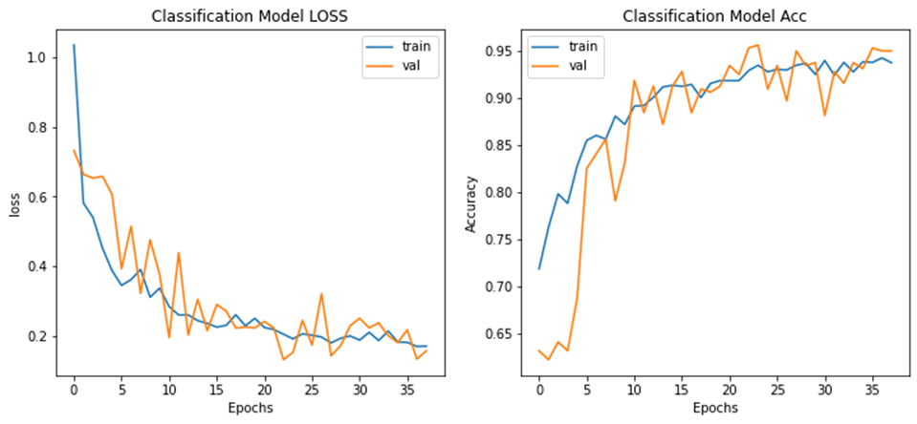
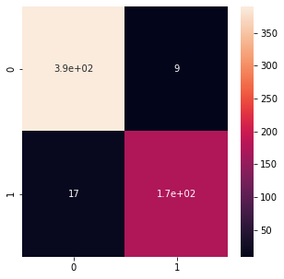
Individual Neural Networks
One network’s statistics
Data augmentation
Transfer learning techniques (weights=‘imagenet’) on a variety of well-known networks
Pooling, Flatten, Dense, Dropout layer structures
Loss = ‘categorical_crossentropy’
Metrics = ‘accuracy’, ‘FalseNegatives’
Optimizers = ‘Adam’, ‘Adagrad’
Early stopping → Maximum of 50 epochs
Accuracy
Loss
Confusion Matrix
True Positive
False Positive
Term | Actual | Prediction
True Positive (TP) | Positive | Positive
True Negative (TN) | Negative | Negative
False Positive (FP) | Negative | Positive
False Negative (FN) | Positive | Negative
False Negative
True Negative
Term | Definition | Formula
Sensitivity | True Positive Rate | TP / (TP + FN)
Specificity | True Negative Rate | TN / (TN + FP)

Slide 7
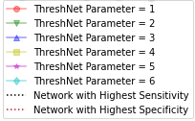
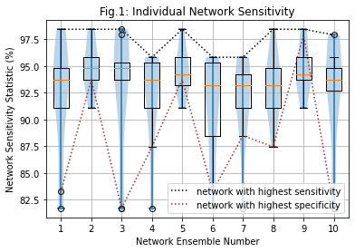
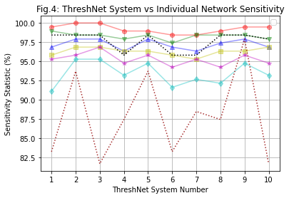
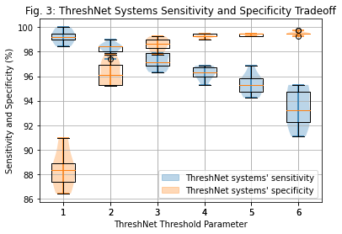
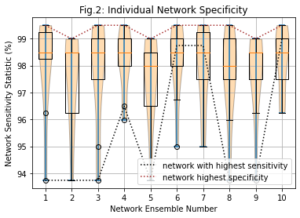
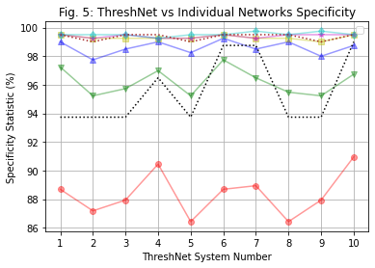
Findings
ThreshNet Systems v.s. Individual Member Networks
Variance among ThreshNet systems are smaller than variance among individual nets (Fig. 3 vs Fig. 1 & 2) → More consistent performance
Performance & tradeoff of ThreshNet parameters (more on next slide)

Slide 8
Results: Performance Metrics
ThreshNet Systems vs Individual Member Networks
Lower ThreshNet Parameter Values (1 - 2):
Systems/network | Sensitivity | Specificity | Accuracy | Comments
ThreshNet=1 | 98.4-100% | 86.4-91.0% | 90.5-93.7% | Sensitivity: Highest, always outperforms best sensitivity individual network by 1-3%. Specificity: lower than best sensitivity individual net.
ThreshNet=2 | 97.3-99.0% | 95.2-97.9% | 96.2-97.8% | Sensitivity: Very high, always outperforms best sensitivity net. Specificity: High, outperforms best sensitivity net 7/10 times.
Best Sensitivity Individual Network | 95.5-98.4% | 93.7-99.0% | 95.4-98.6% | Individual networks with best sensitivity in each ensemble, performance to be compared against ThreshNet (1-2) systems
Higher ThreshNet Parameter Values (4 - 6):
Specificity: Similar to best specificity individual network (difference <1%)
Sensitivity: Significantly improved (up to 15.2%) comparing to best specificity individual network
Medium ThreshNet Parameter Values (3 - 5) :
Well balanced sensitivity and specificity performance metrics
Sensitivity and specificity metrics all in high 90s (%)

Slide 9
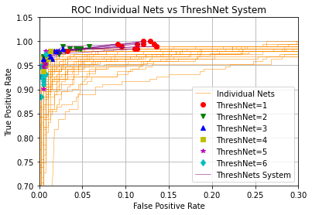
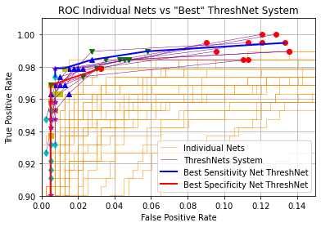
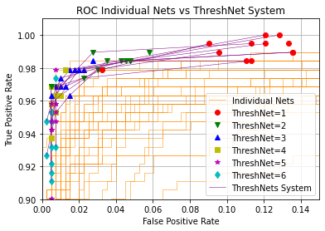
Results: ROC Curves
ThreshNet Systems vs Individual Member Networks
ROC: false positive (sensitivity) vs true positive (1-specificity) rate as probability threshold changes
Randomly selected ThreshNet ensemble members vs “best” ThreshNet ensemble members
Random Ensemble Members
“Best” Ensemble Members
ThreshNet systems consistently perform better than individual networks (closer to upper left corner)
Blue: ThreshNet consisting of 9 highest sensitivity nets
Red: ThreshNet consisting of 9 highest specificity nets
better
ThreshNet with “best” member nets perform very well
Similar to ThreshNet with random member nets
ThreshNet does not need the “best” members to achieve high performance

Slide 10
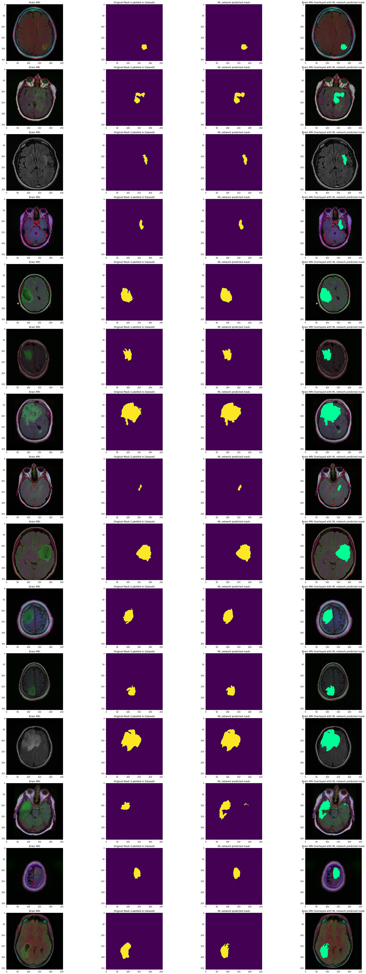
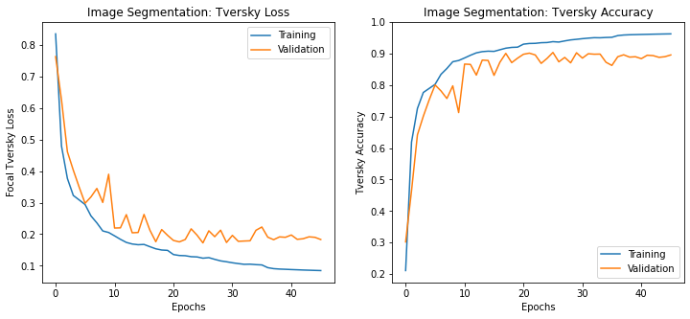
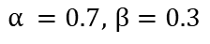
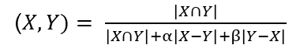
Results: ResUNet Brain Tumor Image Segmentation
Tversky: a measure of similarity between the labelled mask’s pixels and the predicted mask’s pixels through the following formula (X = labelled , Y = prediction):
ResUNet Results: Segmentation Tversky = 90.49%
MRI Image | Labelled Mask | ResUNet | Predicted Overlay
Application in Project:
Areas that ResUNet’s prediction missed (false negative) were more heavily penalized than areas ResUNet’s prediction overmarked (false positive)
($X, Y)= \frac{\left|X∩Y\right|}{\left|X∩Y\right|+α\left|X−Y\right|+β\left|Y−X\right|}$
$α =0.7,$ $β=0.3$

Slide 11
Conclusion
Proposed ThreshNet system generally performs better than individual member networks in particular performance metrics and/or across all performance metrics
ThreshNet provided convenient means to achieve specific performance and trade-off goals between sensitivity and specificity through adjusting the ThreshNet parameter
Optimization goals | ThreshNet configuration
High sensitivity | Low
High specificity | High
Balance between sensitivity and specificity | Medium
Application Examples
Screening tool for brain tumor MRI scans and other medical diagnoses
Establish urgency-based priority queue for medical scans through the ThreshNet parameter
ResUNet image segmentation helps visualize tumor(s) location, assisting professional diagnosis
Variance among ThreshNet systems are smaller than variance among individual nets– more consistent performance
Individual networks in the ensemble do not need to be optimized for ThreshNet to yield high performance.
ResUNet’s predictions closely match dataset’s labelled mask
Future Work
Apply ThreshNet technique to other types of medical diagnoses
Extend outside medical field (e.g. self-driving automobile industry)
Use individual neural network decisions as inputs to train other neural networks
Notes:
How much should I emphasize this is my innovation? Novel approaches seem to be very favored
Don’t add conclusion (civered at the beginning said it all already)

Slide 12
References
[1] Buda, Mateusz, et al. Association of Genomic Subtypes of Lower-Grade Gliomas with Shape Features Automatically Extracted by a Deep Learning Algorithm. Computers in Biology and Medicine, 2019.
[2] Mazurowski, Maciej A., et al. “Radiogenomics of Lower-Grade Glioma: Algorithmically-Assessed Tumor Shape Is Associated with Tumor Genomic Subtypes and Patient Outcomes in a Multi-Institutional Study with The Cancer Genome Atlas Data.” Journal of Neuro-Oncology, U.S. National Library of Medicine, 2017, pubmed.ncbi.nlm.nih.gov/28470431/.
[3] Grote, Thomas, and Philipp Berens. “On the Ethics of Algorithmic Decision-Making in Healthcare.” Journal of Medical Ethics, Institute of Medical Ethics, 1 Mar. 2020, jme.bmj.com/content/46/3/205.citation-tools.
[4] LeCun, Yann, et al. “Convolutional Networks and Applications in Vision.” ResearchGate, May 2010, http://www.researchgate.net/publication/221376179_Convolutional_Networks_and_Applications_in_Vision.
[5] Opitz, D.; Maclin, R. (1999). "Popular ensemble methods: An empirical study". Journal of Artificial Intelligence Research. 11: 169–198. doi:10.1613/jair.614
[6] Abdulla, Waleed. Splash of Color: Instance Segmentation with Mask R-CNN and TensorFlow, 19 Mar. 2018, http://engineering.matterport.com/splash-of-color-instance-segmentation-with-mask-r-cnn-and-tensorflow-7c761e238b46.
[7] Sharma, Pulkit. “Image Segmentation Python: Implementation of Mask R-CNN.” Analytics Vidhya, 22 July 2019, http://www.analyticsvidhya.com/blog/2019/07/computer-vision-implementing-mask-r-cnn-image-segmentation/
[8] Brownlee, Jason. “Best Practices for Preparing and Augmenting Image Data for CNNs.” Machine Learning Mastery, 5 July 2019, http://machinelearningmastery.com/best-practices-for-preparing-and-augmenting-image-data-for-convolutional-neural-networks/
[9] “Sensitivity and Specificity.” Wikipedia, Wikimedia Foundation, 28 Jan. 2021, http://en.wikipedia.org/wiki/Sensitivity_and_specificity.
[10] J. Li et al., “Multi-stage object detection with group recursive learning,” Arxiv.org. [Online]. Available: http://arxiv.org/abs/1608.05159v1. [Accessed: 24-Jul-2020].
[11] O. Ronneberger, P. Fischer, and T. Brox, “U-net: Convolutional networks for biomedical image segmentation,” in International Conference on Medical image computing and computer-assisted intervention. Springer, 2015, pp. 234–241
[12] Zhao, Z. Q., Zheng, P., Xu, S. T., & Wu, X. (2019). Object detection with deep learning: A review. IEEE transactions on neural networks and learning systems, 30(11), 3212-3232.
[13] F. Amato, A. Lopez, E. M. Pena-Mendez, P. Vanhara, A. Hampl, and J. Havel, Eds., Artificial neural networks in medical diagnosis, vol. 11, no. 47–58. Journal of Applied Biomedicine, 2013. Available: doi: 10.2478/v10136-012-0031-x
Supplemental Information
Code and Science Fair Virtual Notebook: https://github.com/shirleytxu/ScienceFairWork

